Slide 1
Introduction to pytest
- simple, powerful, extendable test framework for python
Hong, Dongwei (Wayne)

Slide 2
Topics
Why pytest
Features
assert
mark
fixture
reporting
Plugins
More resources

Slide 3
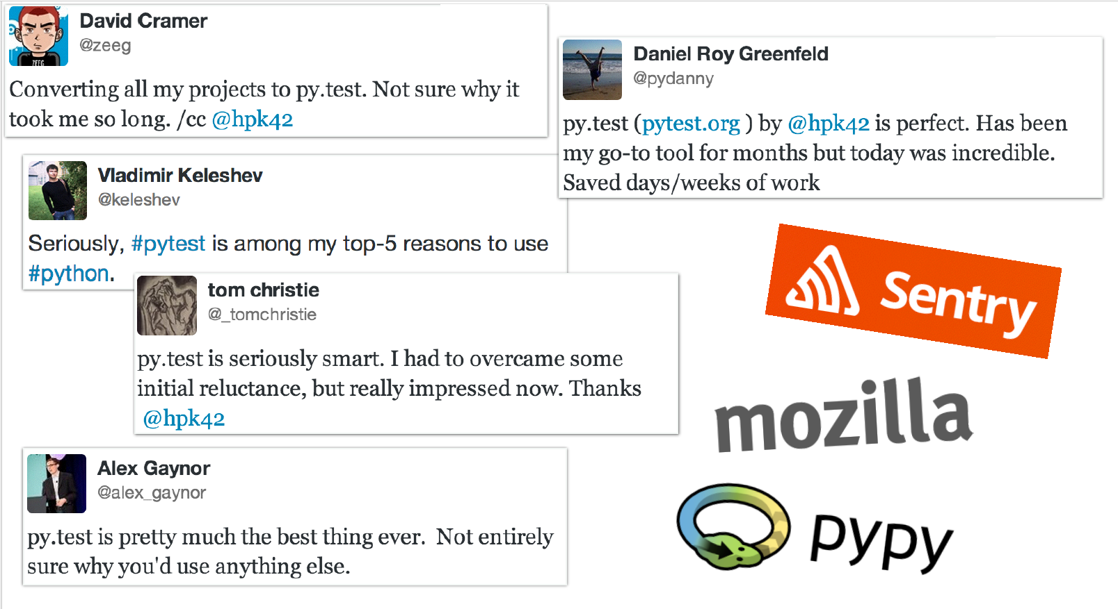
Used by organizations

Slide 4
Used by projects
requests
flask
tox
six
pypy
…

Slide 5
A demo
test using unittest(more java style)
test with pytest test_unittest(more pythonic way)

Slide 6
pytest make life easier
Assertions with plain assert statement
Subclassing TestCase is not required
Tests are found and collected with pytest command automatically.

Slide 7
pytest features
Detailed info on failing assert statements (no need to remember self.assert* names);
Auto-discovery of test modules and functions;
Modular fixtures for managing small or parametrized long-lived test resources;
Can run unittest (including trial) and nose test suites out of the box;
Python 2.7, Python 3.4+, PyPy 2.3, Jython 2.5 (untested);
Rich plugin architecture, with over 315+ external plugins and thriving community;

Slide 8
Assertion rewriting
Assertions about expected exceptions;
Detailed error message with context;
Special comparisons are done for a number of cases;
comparing long strings: a context diff is shown
comparing long sequences: first failing indices
comparing dicts: different entries

Slide 9
Mark
skip - always skip a test function
skipif - skip a test function if a certain condition is met
xfail - produce an “expected failure” outcome if a certain condition is met
parametrize to perform multiple calls to the same test function.
customized mark support

Slide 10
Fixture
As setup/teardown method in other framework.
A prime example of dependency injection.
Scope: sharing a fixture instance across tests in a class, module or session

Slide 11
Reporting
Junit-format xml to integrate with Jenkins and other popular reporting module
Install pytest-html to generate html report

Slide 12
Plugins
pytest-html
pytest-xdist
pytest-regression
pytest-bdd
…

Slide 14
More resources
Demo project:
https://github.com/hdw868/pytest_demo
Further reading:
Python Testing with pytest(by Brian Okken)
Official document

